Slide 1
A Novel Approach for Prefix Minimization using Ternary trie (PMTT) for Packet Classification
Author: Sanchita Saha Ray, Abhishek Chatterjee, Surajeet Ghosh
Conference: TENCON 2014 - 2014 IEEE Region 10 Conference
Presenter: Chih-Hsun Wang
Date: 2015/6/24
Department of Computer Science and Information Engineering
National Cheng Kung University, Taiwan R.O.C.
Notes:
1

Slide 2
Introduction
The TCAM based approaches can provide the excellent performance in terms of table look up capability, but has some problems: less capacity, high price, and very high power consumption.
Because of the Espresso-II minimization technique which increases the entire system complexity super linearly with the increase in number of prefixes and also exponentially increases the required time to update the prefix table.

Slide 3
Introduction
The main objective of the proposed technique is to reduce the storage space requirement for a prefix table and thereby reduce power consumption and cost factor associated with TCAM based prefix table by a healthy margin.
The proposed prefix minimization technique shows 62.5% reduction in routing table size.

Slide 4
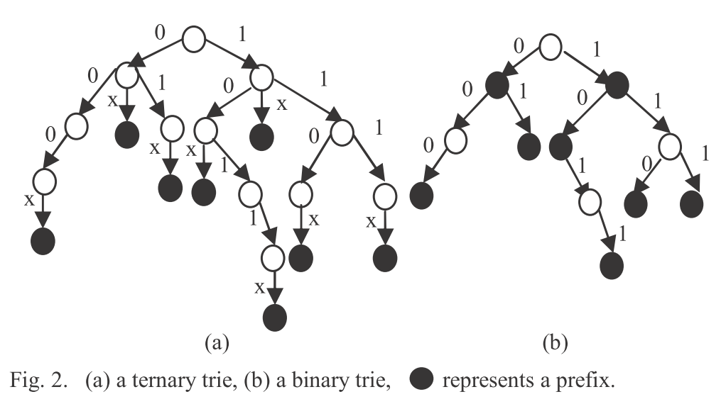
Proposed Scheme
A Novel Ternary Trie
Prefix Set
000*
0*
01*
10*
1011*
1*
110*
111*

Slide 5
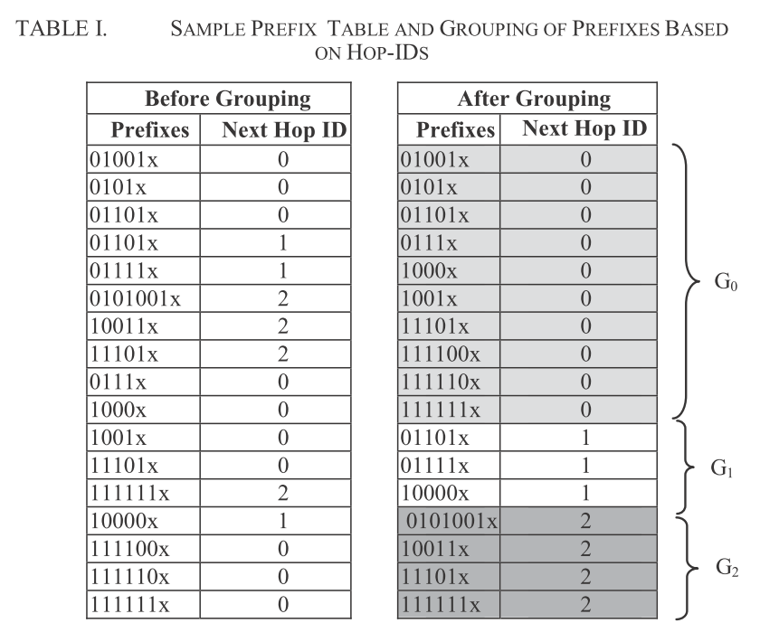
Proposed Scheme
Ternary Trie-based Prefix Minimization

Slide 6
Proposed Scheme
Ternary trie properties
  1. Each node of the tree contains five parts:
  level, data, left child, right child, middle child
  2. Root node contains a dummy value ‘R’
  3. Each node of this tree can have at-most three children
  4. Each unique path from level 1 through leaf node of the ternary tree
  represents an unique prefix for a certain prefix group

Slide 7
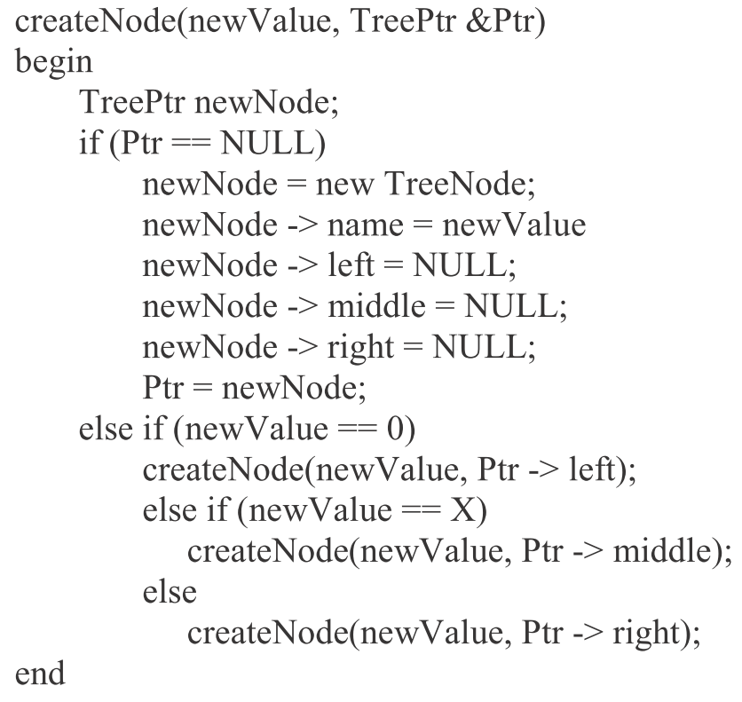
Proposed Scheme
Ternary Tree Creation Phase

Slide 8
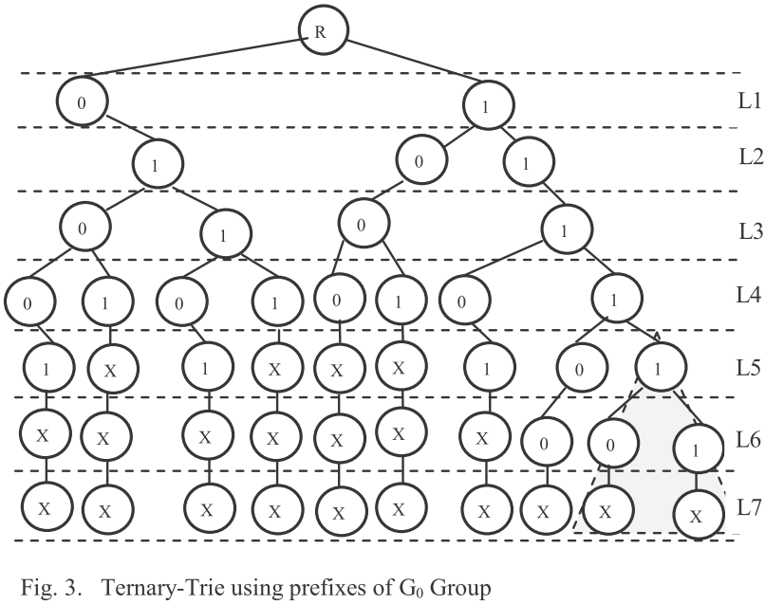
Proposed Scheme

Slide 9
Proposed Scheme
Ternary Tree Merging Phase
  Condition I.
  Two nodes belongs to the same parent node.
  Condition II.
  1. If those two nodes have one identical sub-tree.
  2. If those two nodes have identical combination of any two sub- trees of their own.
  3. If those two nodes have identical left, right and middle sub- trees.
  4. If those two nodes are the leaf nodes of the tree.
Notes:
滿足條件1 及 任一條件 2

Slide 10
Proposed Scheme

Slide 11
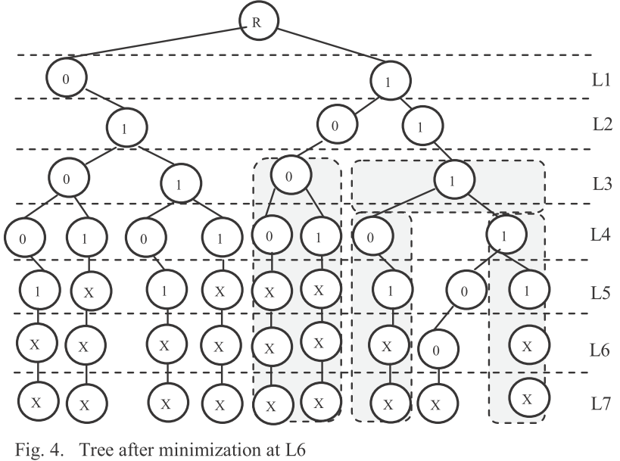
Proposed Scheme

Slide 12
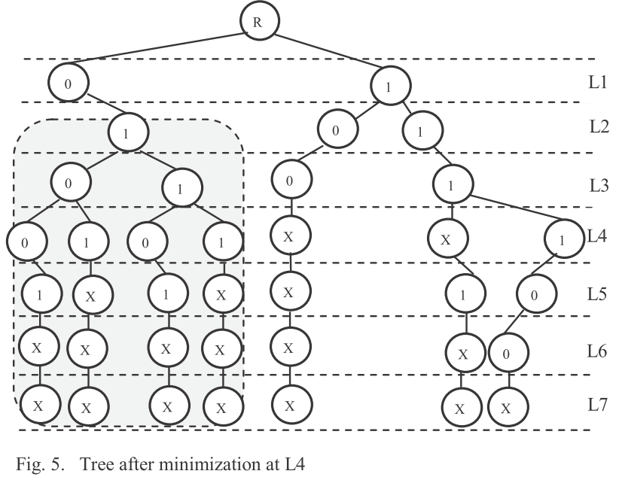
Proposed Scheme

Slide 13
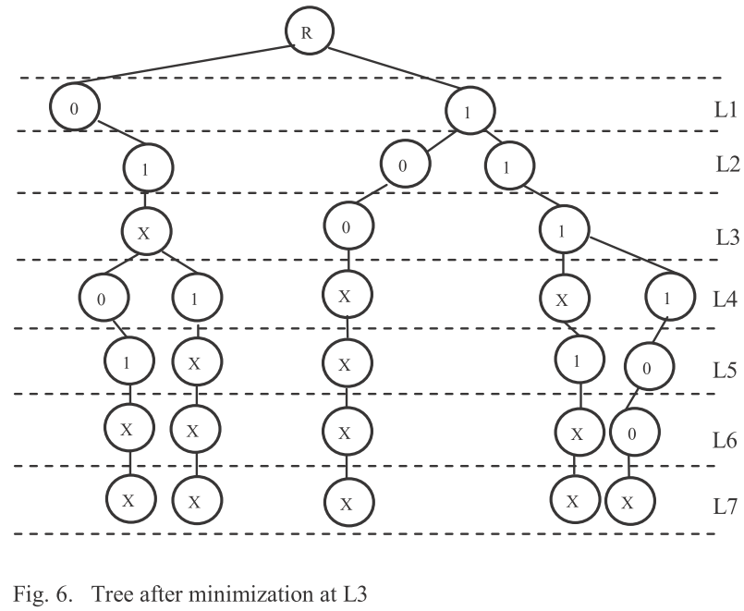
Proposed Scheme

Slide 14
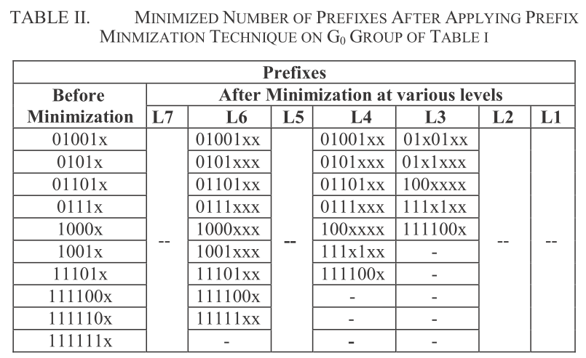
Proposed Scheme

Slide 15
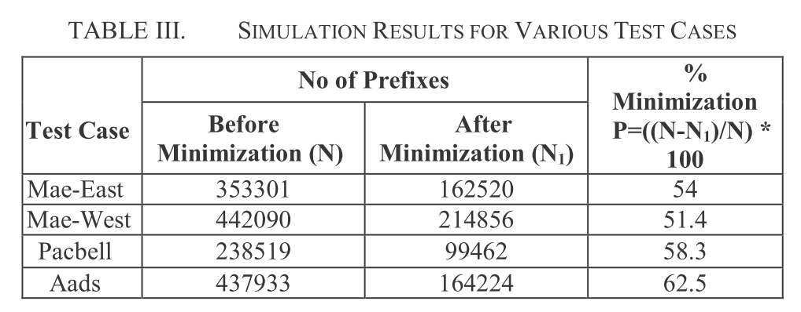
Simulation Result
Notes:
Routing table -> [2]

